Slide 1







Big Data Seminar – BIA 678
Class 4
“The Best Data is More Data” Source unknown.
David Belanger PhD
Senior Research Fellow – Stevens Institute of Technology
dbelange@stevens.edu
1
http://google.com
http://mardigrasneworleans.com

Slide 2
Class 4 - Outline
Administrative Stuff:
Formation of teams
Discussion of potential paper topics
Readings coming up
Guest Speaker: Yifan Hu, Visualization and Machine Learning, April 30.
Assignment #1
Readings (due 3/5):
CAP, IEEE Computer V45 N2 2/2012 pp. 21-58., esp: 21, 23, 30, 37, 43.Lynch & Gilbert, “Perspectives on the CAP Theorem”, http://groups.csail.mit.edu/tds/papers/Gilbert/Brewer2.pdf , 2012
Abadi, et al, “Column-Stores vs. Row-Stores: How Different are they Really, http://db.csail.mit.edu/projects/cstore/abadi-sigmod08.pdf,
Systems homework (Due 2/26): Load Hadoop and Spark onto your laptop. Demonstrate success by doing “ls” on HDFS as in slides 6 and 7 of the Hadoop and Spark Installation slides.
Term Paper Abstract (Due 2/26). Short title and ¼ to ½ page abstract of proposed Term Paper
Due 3/5: Programming assignment: Count digits in e (odd student #) or sqrt(2) (even) using Hadoop.
Activity #2 – MapReduce Examples and Questions
Activity #3 – Start discussion of RDD/Dataframes and Data Management

Slide 3
Example 4: Simple Statistics – Count/Mean/Variance
Count:
Mean:
Pairwise Variance Algorithm:

Slide 4
Python for Simple Statistics
1 2 3 4 5 6 7 8 9 10 11 12 13 14 15 16 17 18 19 20 | import numpy def mapFunc(row): "Calculate the statistics for a single row of data." return (numpy.size(row), numpy.mean(row), numpy.var(row)) def reduceFunc(row1, row2): "Calculate the combined statistics from two rows of data." n_a, mean_a, var_a = row1 n_b, mean_b, var_b = row2 n_ab = n_a + n_b mean_ab = ((mean_a * n_a) + (mean_b * n_b)) / n_ab var_ab = (((n_a * var_a) + (n_b * var_b)) / n_ab) + ((n_a * n_b) * ((mean_b - mean_a) / n_ab)**2) return (n_ab, mean_ab, var_ab) numRows = 100 numSamplesPerRow = 500 x = numpy.random.rand(numRows, numSamplesPerRow) y = reduce(reduceFunc, map(mapFunc, x)) print "n=%d, mean=%f, var=%f" % y
http://blog.cordiner.net/2010/06/16/calculating-variance-and-mean-with-mapreduce-python/

Slide 5
Map Reduce Example Mean
Problem: Find the mean of a set of numbers.
Input: A set of numbers in the form:
<key, Number>.
Mapper:
Sum = 0
Count = 0
Until end of number list
Read next <key, value>
Sum = Sum + value
Count = Count + 1
Output <1, Value of Sum Value of Count>

Slide 6
Map Reduce Example Mean
Result of Mappers: A set of <key, value> pairs of the form <1, Value of Sum, Value of Count>
Reducer:
Total-Sum = 0
Total-Count = 0
Until end of <k,v> pairs from mappers
Read next <key, value>
Total-Sum= Total-Sum + Value of Sum
Total-Count = Total-Count + Value of Count
Output Total-Sum/Total-Count

Slide 7
Map Reduce Example Variance
Problem: Find the variance of a set of numbers.
Input: A set of numbers in the form:
<key, Number> from several distributed datasets.
Mapper:
Until end of number list
Read key value pairs <key, value>
Calculate Count, Mean and Variance of the dataset.
Output <1, Count Mean Variance> That is: the “value” in this key value pair is the tuple count mean, variance.

Slide 8

Map Reduce Example Variance
Result of Mappers: A set of <key, value> pairs of the form <1, count mean variance>
Reducer:
Input the Mappers’ key/value pairs, and
Using the formula at the bottom of this slide, calculate the total variance – warning: due to round-off error care much be taken.
Output Total
Formula for calculating the Total Variance of a set of n numbers divided into g sets with k_{i} variance V_{i} and mean m ( X_{i} ), and Total Mean m(X), then:

Slide 9
Distributed Grep
Very popular example to explain how Map-Reduce works
Demo program comes with Nutch (where Hadoop originated)

Slide 10
Distributed Grep
For Unix guru: grep -Eh <regex> <inDir>/* | sort | uniq -c | sort -nr - counts lines in all files in <inDir> that match <regex> and displays the counts in descending order - grep -Eh 'A|C' in/* | sort | uniq -c | sort -nr - Analyzing web server access logs to find the top requested pages that match a given pattern
File 1
C
B
B
C
File 2
Result
C
A
3 C
1 A

Slide 11
Distributed Grep
Map function in this case: - input is (file offset, line) - output is either:
1. an empty list [] (the line does not match) 2. a key-value pair [(line, 1)] (if it matches) Reduce function in this case: - input is (line, [1, 1, ...]) - output is (line, n) where n is the number of 1s in the list.

Slide 12
Distributed Grep
Grep [AC]
File 1
C
B
B
C
File 2
Result
C
A
3 C
1 A
Map tasks: (0, C) -> [(C, 1)] (2, B) -> [] (4, B) -> [] (6, C) -> [(C, 1)] (0, C) -> [(C, 1)] (2, A) -> [(A, 1)]
Reduce tasks: (A, [1]) -> (A, 1) (C, [1, 1, 1]) -> (C, 3)

Slide 13
Map Reduce Example How Many Friends in Common
Problem: Given data from a social network, like Facebook, which records all of your friends, and assuming that the friend relationship if bidirectional, calculate the number of friends any pair of people have in common.
Input: A dataset with records of the form Person -> List of Friends:
<Individual, List of Friends> possibly from several distributed datasets.
Mapper:
Consider what the k/v pairs that will be sent to the Reducer must be.

Slide 14
Map Reduce Example How Many Friends in Common
Mapper:
Consider what the k/v pairs that will be sent to the Reducer must be.
First it must have a key which will make sure that every pair of friends ends up at the same reducer (i.e. (A, B) where A and B are friends and A < B.
Then, it must contain, as value, the list of A’s friends and the list of B’s friends, so that the reducer can intersect the 2 sets.
Collect the set of all friends for each person, and for each pair of friends output:
<(A,B), (list of A’s friends)(list of B’s friends)> Where A < B

Slide 15
Map Reduce Example How Many Friends in Common
Result of Mappers: A set of <key, value> pairs of the form: <(A,B), (list of A’s friends)(list of B’s friends)> Where A < B
Reducers:
Input the Mappers’ key/value pairs, and
For each friend pair (A,B) collect all of the Key/Value pairs with that as a key
For each set of pairs with (A,B) as a key, complete the list of A’s friends, and the list of B’s friends
Take the intersection of these 2 lists, and count the number, n(A,B) in that intersection
Output A, B, n(A,B)

Slide 16
Map Reduce Example How Many Friends in Common Toy Example: From: http://stevekrenzel.com/finding-friends-with-mapreduce
Mapper Input K/V, Friend Lists:
A -> B C D
B -> A C D E
C -> A B D E
D -> A B C E
E -> B C D

Slide 17
Map Reduce Example How Many Friends in Common Toy Example: From: http://stevekrenzel.com/finding-friends-with-mapreduce
Mapper Output K/V, Common Friend Lists:
For map(A -> B C D) :
(A B) -> B C D
(A C) -> B C D
(A D) -> B C D
For map(B -> A C D E) : (Note that A comes before B in the key)
(A B) -> A C D E
(B C) -> A C D E
(B D) -> A C D E
(B E) -> A C D E
For map(C -> A B D E) :
(A C) -> A B D E
(B C) -> A B D E
(C D) -> A B D E
(C E) -> A B D E
For map(D -> A B C E) :
(A D) -> A B C E
(B D) -> A B C E
(C D) -> A B C E
(D E) -> A B C E
And finally for map(E -> B C D):
(B E) -> B C D
(C E) -> B C D
(D E) -> B C D

Slide 18
Map Reduce Example How Many Friends in Common Toy Example: From: http://stevekrenzel.com/finding-friends-with-mapreduce
After Shuffle/Sort (input to reducers) K/V, Friend Lists:
(A B) -> (A C D E) (B C D)
(A C) -> (A B D E) (B C D)
(A D) -> (A B C E) (B C D)
(B C) -> (A B D E) (A C D E)
(B D) -> (A B C E) (A C D E)
(B E) -> (A C D E) (B C D)
(C D) -> (A B C E) (A B D E)
(C E) -> (A B D E) (B C D)
(D E) -> (A B C E) (B C D)

Slide 19
Map Reduce Example How Many Friends in Common Toy Example: From: http://stevekrenzel.com/finding-friends-with-mapreduce
Results , Common Friend Lists:
(A B) -> (C D)
(A C) -> (B D)
(A D) -> (B C)
(B C) -> (A D E)
(B D) -> (A C E)
(B E) -> (C D)
(C D) -> (A B E)
(C E) -> (B D)
(D E) -> (B C)

Slide 20
Map Reduce Example How Many Friends in Common Toy Example: From: http://stevekrenzel.com/finding-friends-with-mapreduce
But what if the input file only had the individual edges? E.g. A -> B

Slide 21
Map Reduce Example Matrix Multiplication
Problem: Given two rectangular matrices, A which is mxn, and B which is nxp, calculate C an mxp matrix which is the product of the two.
Input: Two matrices A and B, with rows and column data that may be distributed across many sites.

Slide 22
Map Reduce Example Matrix Multiplication
Mapper:
Consider that the k/v pairs that will be sent to the Reducer must:
Allow each reducer much have the data to calculate C_{ij} for the some any (I,j) assigned to it, and the set of reducers must cover all of the (I,j) pairs.
So, a mapper should output k/v pairs who’s keys are either a_{i*} or b_{*j} . That is, they have a constant “i” for the a values and a constant “j” for the b values.

Slide 23
Map Reduce Example Matrix Multiplication
Result of Mappers: A set of <key, value> pairs of the form:
If an “A” value <(i, k), where “i” is the A index, and “k” is each of the possible B indices.> One K/V for each pair, and
If an “B” value <(k, j), where “j” is the B index, and “k” is each of the possible A indices.> One K/V for each pair
Reducers:
Input the Mappers’ key/value pairs, and
For each c(I,j) calcualate SUM over all k of a(I,k)*b(k,j)
For each c(I,j) output its value

Slide 24
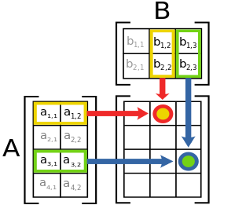


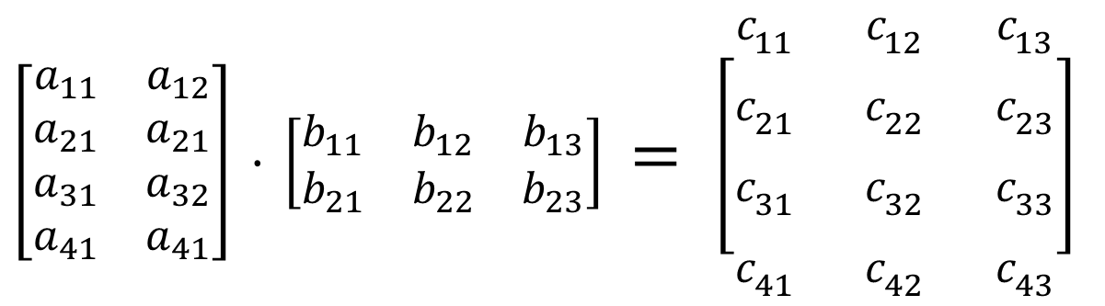

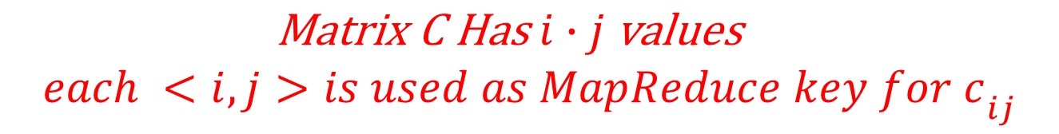
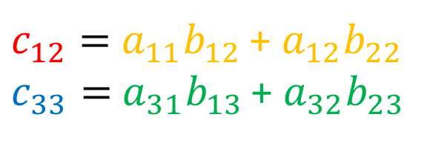
Example 3: Matrix Multiplication
$$A_{ik}$$
$$B_{kj}$$
$$C_{ij}$$
$\left[\begin{matrix}a_{11} & a_{12} \\ a_{21} & a_{21} \\ a_{31} & a_{32} \\ a_{41} & a_{41}\end{matrix}\right]$ $∙ \left[\begin{matrix}b_{11} & b_{12} & b_{13} \\ b_{21} & b_{22} & b_{23}\end{matrix}\right]$ $= \left[\begin{matrix}c_{11} & c_{12} & c_{13} \\ c_{21} & c_{22} & c_{23} \\ c_{31} & c_{32} & c_{33} \\ c_{41} & c_{42} & c_{43}\end{matrix}\right]$
$c_{12}=$ $a_{11}b_{12 }$+ $a_{12}b_{22 }$
$c_{33}=$ $a_{31}b_{13 }$+ $a_{32}b_{23 }$
$${\begin{aligned}\text{Matrix} \text{C} \text{Has} i∙j \text{values} \\ each <i, j>is used as MapReduce key for c\end{aligned}}_{ij}$$

Slide 25

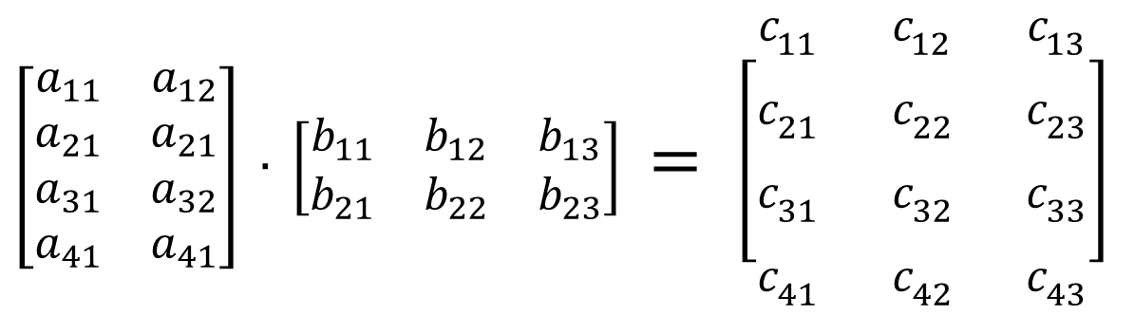

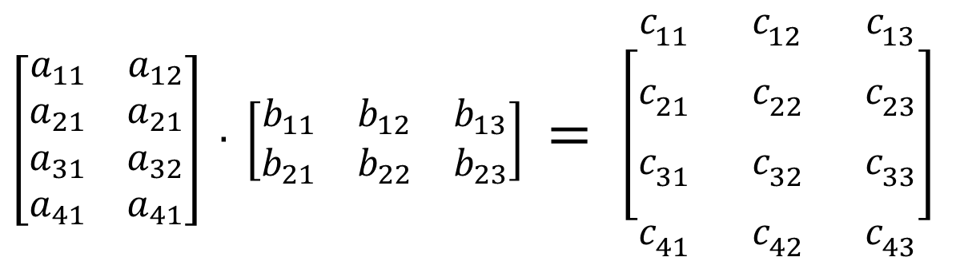

Matrix Multiplication: Map Phase
$$A_{ik}$$
$$B_{kj}$$
$$C_{ij}$$
$\left[\begin{matrix}a_{11} & a_{12} \\ a_{21} & a_{21} \\ a_{31} & a_{32} \\ a_{41} & a_{41}\end{matrix}\right]$ $∙ \left[\begin{matrix}b_{11} & b_{12} & b_{13} \\ b_{21} & b_{22} & b_{23}\end{matrix}\right]$ $= \left[\begin{matrix}c_{11} & c_{12} & c_{13} \\ c_{21} & c_{22} & c_{23} \\ c_{31} & c_{32} & c_{33} \\ c_{41} & c_{42} & c_{43}\end{matrix}\right]$
$a_{31} w$ill be sent 3 times with key <3,1>, <3,2>, <3,3>
$\left[\begin{matrix}a_{11} & a_{12} \\ a_{21} & a_{21} \\ a_{31} & a_{32} \\ a_{41} & a_{41}\end{matrix}\right]$ $∙ \left[\begin{matrix}b_{11} & b_{12} & b_{13} \\ b_{21} & b_{22} & b_{23}\end{matrix}\right]$ $= \left[\begin{matrix}c_{11} & c_{12} & c_{13} \\ c_{21} & c_{22} & c_{23} \\ c_{31} & c_{32} & c_{33} \\ c_{41} & c_{42} & c_{43}\end{matrix}\right]$
$b_{12} w$ill be sent 4 times with key <1,2>, <2,2>, <3,2>, <4,2>

Slide 26
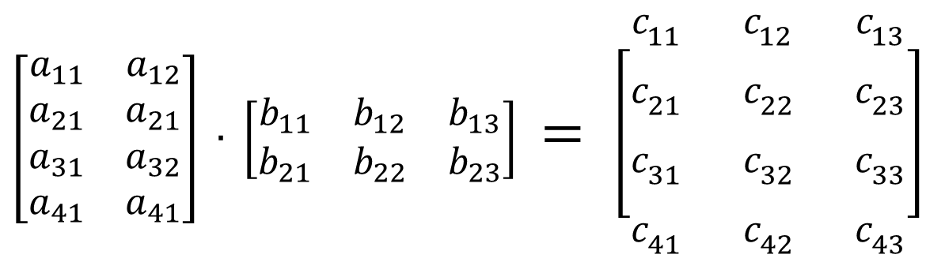
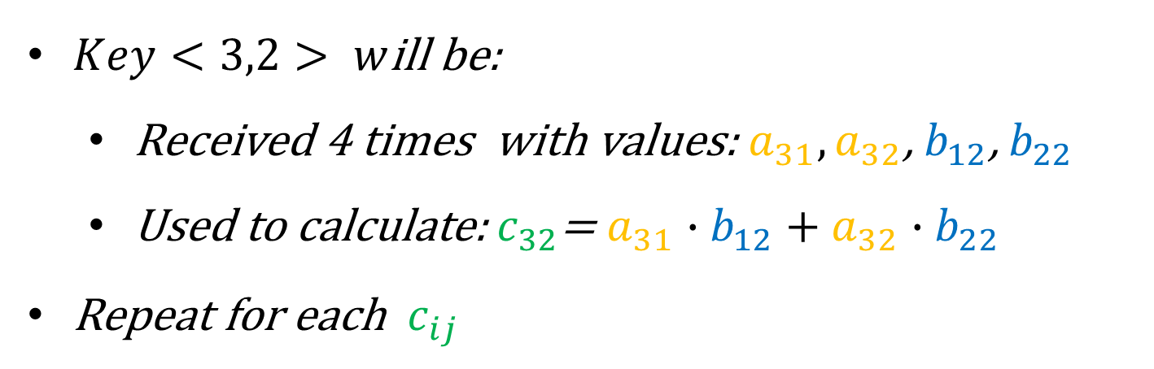



Matrix Multiplication: Reduce Phase
$$A_{ik}$$
$$B_{kj}$$
$$C_{ij}$$
$\left[\begin{matrix}a_{11} & a_{12} \\ a_{21} & a_{21} \\ a_{31} & a_{32} \\ a_{41} & a_{41}\end{matrix}\right]$ $∙ \left[\begin{matrix}b_{11} & b_{12} & b_{13} \\ b_{21} & b_{22} & b_{23}\end{matrix}\right]$ $= \left[\begin{matrix}c_{11} & c_{12} & c_{13} \\ c_{21} & c_{22} & c_{23} \\ c_{31} & c_{32} & c_{33} \\ c_{41} & c_{42} & c_{43}\end{matrix}\right]$
$Key<3,2> w$ill be:
Received 4 times with values: $a_{31},a_{32}$, $b_{12}$, $b_{22}$
Used to calculate:$c_{32}$= $a_{31}∙b_{12}+$ ${a_{32}∙b}_{22}$
Repeat for each $c_{ij}$

Slide 27

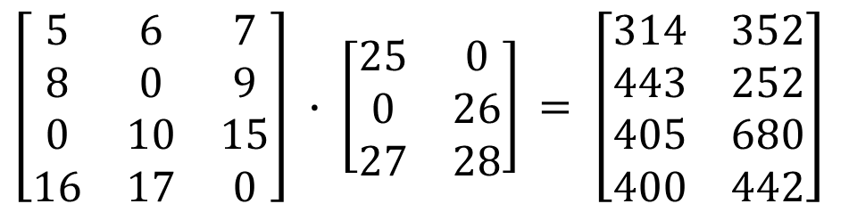

Matrix Multiplication: Real Case
$\left[\begin{matrix}5 & 6 & 7 \\ 8 & 0 & 9 \\ 0 & 10 & 15 \\ 16 & 17 & 0\end{matrix}\right]$ $∙ \left[\begin{matrix}25 & 0 \\ 0 & 26 \\ 27 & 28\end{matrix}\right]$ $= \left[\begin{matrix}314 & 352 \\ 443 & 252 \\ 405 & 680 \\ 400 & 442\end{matrix}\right]$
Row | Col | Value
1 | 1 | 5
1 | 2 | 6
1 | 3 | 7
2 | 1 | 8
2 | 3 | 9
3 | 2 | 10
3 | 3 | 15
4 | 1 | 16
4 | 2 | 17
Row | Col | Value
1 | 1 | 314
1 | 2 | 352
2 | 1 | 443
2 | 2 | 252
3 | 1 | 405
3 | 2 | 680
4 | 1 | 400
4 | 2 | 442
Row | Col | Value
1 | 1 | 25
2 | 2 | 26
3 | 1 | 27
3 | 2 | 28
$$∙$$
$$=$$

Slide 28
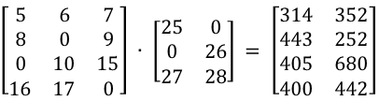
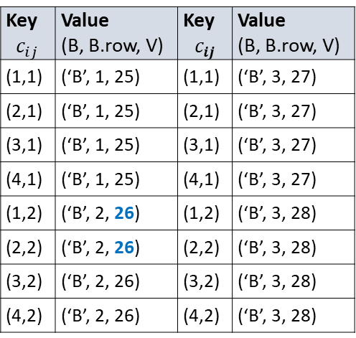
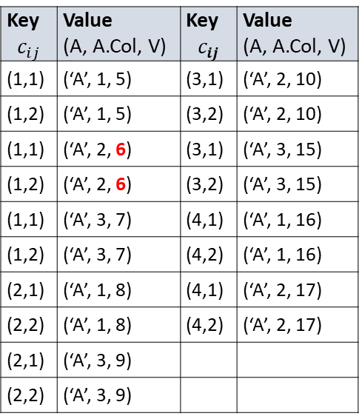
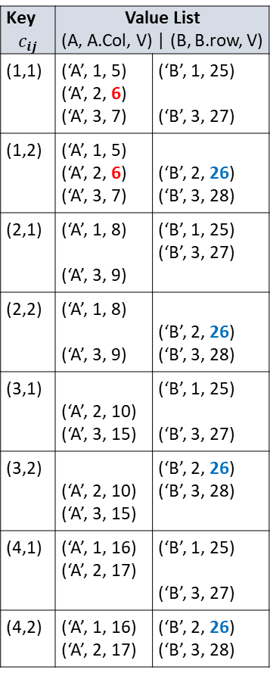
Key $$c_{ij}$$ | Value (A, A.Col, V) | Key $$c_{ij}$$ | Value (A, A.Col, V)
(1,1) | (‘A’, 1, 5) | (3,1) | (‘A’, 2, 10)
(1,2) | (‘A’, 1, 5) | (3,2) | (‘A’, 2, 10)
(1,1) | (‘A’, 2, 6) | (3,1) | (‘A’, 3, 15)
(1,2) | (‘A’, 2, 6) | (3,2) | (‘A’, 3, 15)
(1,1) | (‘A’, 3, 7) | (4,1) | (‘A’, 1, 16)
(1,2) | (‘A’, 3, 7) | (4,2) | (‘A’, 1, 16)
(2,1) | (‘A’, 1, 8) | (4,1) | (‘A’, 2, 17)
(2,2) | (‘A’, 1, 8) | (4,2) | (‘A’, 2, 17)
(2,1) | (‘A’, 3, 9)
(2,2) | (‘A’, 3, 9)
Key $$c_{ij}$$ | Value List (A, A.Col, V) | (B, B.row, V)
(1,1) | (‘A’, 1, 5) (‘A’, 2, 6) (‘A’, 3, 7) | (‘B’, 1, 25) (‘B’, 3, 27)
(1,2) | (‘A’, 1, 5) (‘A’, 2, 6) (‘A’, 3, 7) | (‘B’, 2, 26) (‘B’, 3, 28)
(2,1) | (‘A’, 1, 8) (‘A’, 3, 9) | (‘B’, 1, 25) (‘B’, 3, 27)
(2,2) | (‘A’, 1, 8) (‘A’, 3, 9) | (‘B’, 2, 26) (‘B’, 3, 28)
(3,1) | (‘A’, 2, 10) (‘A’, 3, 15) | (‘B’, 1, 25) (‘B’, 3, 27)
(3,2) | (‘A’, 2, 10) (‘A’, 3, 15) | (‘B’, 2, 26) (‘B’, 3, 28)
(4,1) | (‘A’, 1, 16) (‘A’, 2, 17) | (‘B’, 1, 25) (‘B’, 3, 27)
(4,2) | (‘A’, 1, 16) (‘A’, 2, 17) | (‘B’, 2, 26) (‘B’, 3, 28)
6 * 26
+
7 * 28
=352
A. Row | A. Col | A. Value
1 | 1 | 5
1 | 2 | 6
1 | 3 | 7
2 | 1 | 8
2 | 3 | 9
3 | 2 | 10
3 | 3 | 15
4 | 1 | 16
4 | 2 | 17
SORT & SHUFFLE
MAP MAP
C. Row | C. Col | C. Value
1 | 1 | 314
1 | 2 | 352
2 | 1 | 443
2 | 2 | 252
3 | 1 | 405
3 | 2 | 680
4 | 1 | 400
4 | 2 | 442
REDUCE
Key $$c_{ij}$$ | Value (B, B.row, V) | Key $$c_{ij}$$ | Value (B, B.row, V)
(1,1) | (‘B’, 1, 25) | (1,1) | (‘B’, 3, 27)
(2,1) | (‘B’, 1, 25) | (2,1) | (‘B’, 3, 27)
(3,1) | (‘B’, 1, 25) | (3,1) | (‘B’, 3, 27)
(4,1) | (‘B’, 1, 25) | (4,1) | (‘B’, 3, 27)
(1,2) | (‘B’, 2, 26) | (1,2) | (‘B’, 3, 28)
(2,2) | (‘B’, 2, 26) | (2,2) | (‘B’, 3, 28)
(3,2) | (‘B’, 2, 26) | (3,2) | (‘B’, 3, 28)
(4,2) | (‘B’, 2, 26) | (4,2) | (‘B’, 3, 28)
B. Row | B. Col | B. Value
1 | 1 | 25
2 | 2 | 26
3 | 1 | 27
3 | 2 | 28

Slide 29
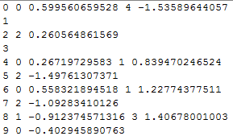

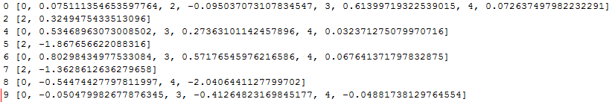
Python Code for Matrix Multiplication
Sparse Matrix Multiplication
https://github.com/dgleich/matrix-hadoop-tutorial.git

Slide 30
Matrix Multiplication Using MapReduce
BIA 676 Spring 2015

Slide 31
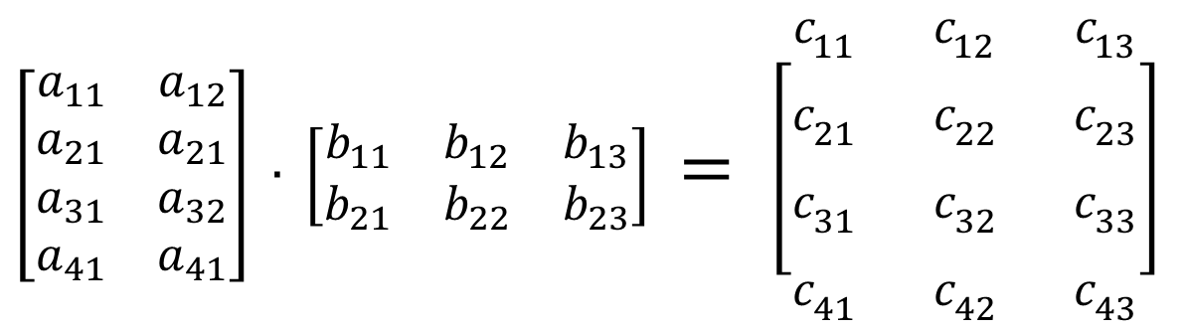
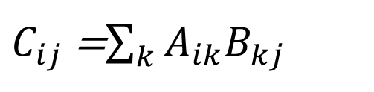
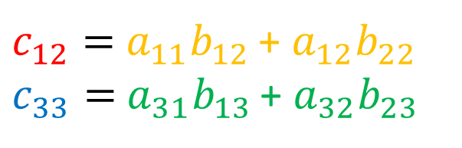
Matrix Multiplication
$$A_{ik}$$
$$B_{kj}$$
$$C_{ij}$$
$\left[\begin{matrix}a_{11} & a_{12} \\ a_{21} & a_{21} \\ a_{31} & a_{32} \\ a_{41} & a_{41}\end{matrix}\right]$ $∙ \left[\begin{matrix}b_{11} & b_{12} & b_{13} \\ b_{21} & b_{22} & b_{23}\end{matrix}\right]$ $= \left[\begin{matrix}c_{11} & c_{12} & c_{13} \\ c_{21} & c_{22} & c_{23} \\ c_{31} & c_{32} & c_{33} \\ c_{41} & c_{42} & c_{43}\end{matrix}\right]$
$c_{12}=$ $a_{11}b_{12 }$+ $a_{12}b_{22 }$
$c_{33}=$ $a_{31}b_{13 }$+ $a_{32}b_{23 }$
$C_{ij}$ =$\sum_{k}{A_{ik}B_{kj}}$

Slide 32

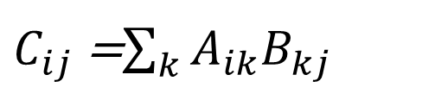
Matrix Multiplication: Patterns
Notice:
Values from matrix A and B will only be multiplied for the same k. (i.e., the column index of A has to match the row index of B)
The row index of A and the column index of B becomes the row and column index of C, respectively.
$c_{12}=$ $a_{11}b_{12 }$+ $a_{12}b_{22 }$
$c_{33}=$ $a_{31}b_{13 }$+ $a_{32}b_{23 }$
More generally,
$C_{ij}$ =$\sum_{k}{A_{ik}B_{kj}}$

Slide 33
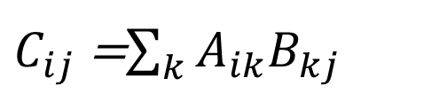
Converting patterns to MapReduce
$C_{ij}$ =$\sum_{k}{A_{ik}B_{kj}}$
Pattern
MapReduce
Values from matrix A and B will only be multiplied for the same k. (i.e., the column index of A has to match the row index of B)
The row index of A and the column index of B becomes the row and column index of C, respectively. For every k, A and B are multiplied for all possible values of i and j
For every element in each matrix, map to: <k, (‘A’, i, value)>, where k = A.col and i = A.row <k, (‘B’, j, value)>, where k = B.row and j = B.col
For every key k, reduce values to: <(i, j), (list of every possible permutation of A*B)> To get final answer, add the list of A*B’s.

Slide 34

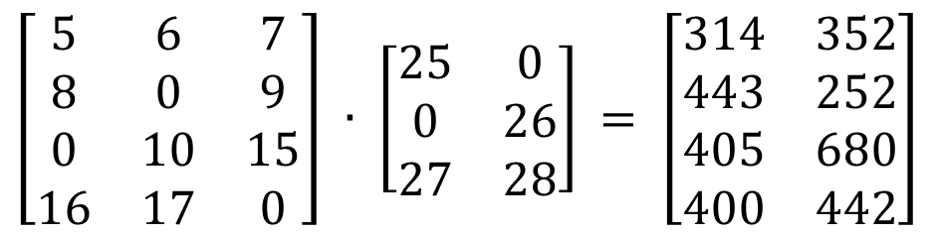

Matrix Multiplication: Real Case
$\left[\begin{matrix}5 & 6 & 7 \\ 8 & 0 & 9 \\ 0 & 10 & 15 \\ 16 & 17 & 0\end{matrix}\right]$ $∙ \left[\begin{matrix}25 & 0 \\ 0 & 26 \\ 27 & 28\end{matrix}\right]$ $= \left[\begin{matrix}314 & 352 \\ 443 & 252 \\ 405 & 680 \\ 400 & 442\end{matrix}\right]$
Row | Col | Value
1 | 1 | 5
1 | 2 | 6
1 | 3 | 7
2 | 1 | 8
2 | 3 | 9
3 | 2 | 10
3 | 3 | 15
4 | 1 | 16
4 | 2 | 17
Row | Col | Value
1 | 1 | 314
1 | 2 | 352
2 | 1 | 443
2 | 2 | 252
3 | 1 | 405
3 | 2 | 680
4 | 1 | 400
4 | 2 | 442
Row | Col | Value
1 | 1 | 25
2 | 2 | 26
3 | 1 | 27
3 | 2 | 28
$$∙$$
$$=$$

Slide 35
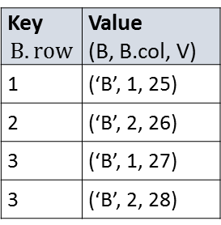
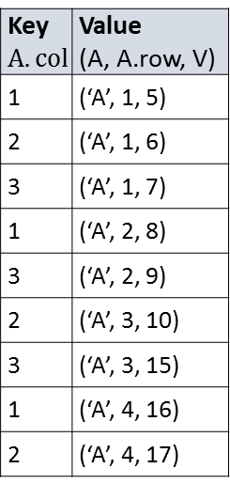
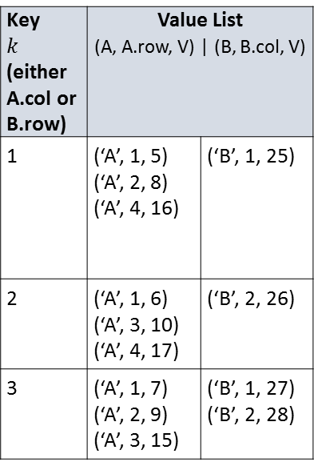
Key $$A.col$$ | Value (A, A.row, V)
1 | (‘A’, 1, 5)
2 | (‘A’, 1, 6)
3 | (‘A’, 1, 7)
1 | (‘A’, 2, 8)
3 | (‘A’, 2, 9)
2 | (‘A’, 3, 10)
3 | (‘A’, 3, 15)
1 | (‘A’, 4, 16)
2 | (‘A’, 4, 17)
A.row and B.col correspond to the same
C.Row and C.col
A. Row | A. Col | A. Value
1 | 1 | 5
1 | 2 | 6
1 | 3 | 7
2 | 1 | 8
2 | 3 | 9
3 | 2 | 10
3 | 3 | 15
4 | 1 | 16
4 | 2 | 17
SORT & SHUFFLE
MAP MAP
Key $k$ (either A.col or B.row) | Value List (A, A.row, V) | (B, B.col, V)
1 | (‘A’, 1, 5) (‘A’, 2, 8) (‘A’, 4, 16) | (‘B’, 1, 25)
2 | (‘A’, 1, 6) (‘A’, 3, 10) (‘A’, 4, 17) | (‘B’, 2, 26)
3 | (‘A’, 1, 7) (‘A’, 2, 9) (‘A’, 3, 15) | (‘B’, 1, 27) (‘B’, 2, 28)
C. Row | C. Col | C. Value
1 | 1 | 5*25,7*27
1 | 2 | 6*26, 1*28
2 | 1 | 8*25, 9*27
2 | 2 | 9*28
3 | 1 | 15*27
3 | 2 | 10*26, 15*28
4 | 1 | 16*25
4 | 2 | 17*26
C. Row | C. Col | C. Value
1 | 1 | 314
1 | 2 | 352
2 | 1 | 443
2 | 2 | 252
3 | 1 | 405
3 | 2 | 680
4 | 1 | 400
4 | 2 | 442
REDUCE
REDUCE
B. Row | B. Col | B. Value
1 | 1 | 25
2 | 2 | 26
3 | 1 | 27
3 | 2 | 28
Key $$B.row$$ | Value (B, B.col, V)
1 | (‘B’, 1, 25)
2 | (‘B’, 2, 26)
3 | (‘B’, 1, 27)
3 | (‘B’, 2, 28)

Slide 36
Obtaining and Running Code
Update MRJOB on cloudera (to at least 0.4.3):
$ pip install mrjob --upgrade
Run Python job for matrix multiplication
Get code and data from: https://gist.github.com/syju/dcaf55454dbe8b6d157c
$ export HADOOP_HOME=/usr/
$ python MatrixMultiplication.py -r hadoop smat_10_5_A.txt mat_5_5.txt -o /user/cloudera/results/MatrixMultiplication

Slide 37
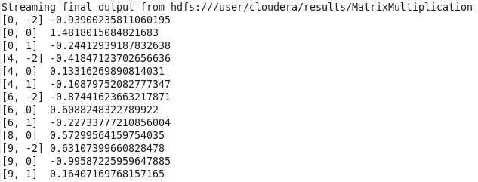
Final Output

Slide 38
Map Reduce Example Multi Term Search
Problem: Given many sets of documents, which might be, for example, web pages, logs, or text, and a set of terms for matching; return a list of “lines” from the input data that match that set. In the case of web pages it could be URLs that are returned.
Input: A large set of documents containing words that can be matched. Words could be in a natural language, or could be, for example, IP addresses.

Slide 39
Map Reduce Example Multi Term Search
Mapper:
Consider that the k/v pairs that will be sent to the Reducer must:
Simply provide the output that the reducer will produce to identify that selected “lines”
So, a mapper should output k/v pairs who’s keys are of the form: < anything, selected line>

Slide 40
Map Reduce Example Multi Term Search
Result of Mappers: A set of <key, value> pairs of the form:
K/V pairs of the form < anything, selected “line”>
Reducers:
Output the selected lines (no page ranking, etc. requested for this problem).

Slide 41
Map Reduce Example Retail Purchases
Problem: A retail establishment, on/off line, wishes to determine what “types” of products are most often purchased together (e.g. if on-line, in a single cart). The plan is to use this information to recommend additional purchases as in “Customers who purchased these, also purchased”.
Input: A collection of records of the form:
Unique identifier (possibly anonymized) for the purchasing session; lists of items purchased (probably be item number); date, time, dollar value.

Slide 42
Map Reduce Example Retail Purchases
Mapper:
Consider that the k/v pairs that will be sent to the Reducer must:
Identify the most common lists of purchases bought in the same session,
Insure that similar lists go to the same reducer
Challenges include the fact that some of the lists could be quite long.
A possible Mapper output could have as Key (a sorted list of the first X products in a given session). Limiting X to address the long list issue. There are many possible refinements.
Another possibility would be to output pairs, triples, quadruples, etc. as key, with the frequency of occurence. Could cause an explosion of output.

Slide 43
Map Reduce Example Retail Purchases
Result of Mappers: Assuming the first approach with a defined X, a set of <key, value> pairs of the form:
K/V pairs of the form < sorted list of first X products, total sorted list for a session>
Reducers:
Reducer now has several problems:
First, of course there will be some items not counted because X is too small.
Second, reducer must take all product intersections and count them.
Output: A set of lists of products, with their frequency of occurrence.

Slide 44
Influence Calculation in the Erdos Graph
BIA 676 Spring 2015
https://files.oakland.edu/users/grossman/enp/Erdos1.html

Slide 45
One Approach
Influence for a node can be calculated by counting all of its connections of length 1 and length 2
We can simplify the connections for a node such that all connections of length 1 and length 2 are represented as connections of length 1:
6
3
6
3
5
1
2
5
1
2
7
4
7
4

Slide 46
Obtaining and Running Code
Update MRJOB on cloudera (you will need version 0.4.3):
$ pip install mrjob --upgrade
Run Python job for influence calculation
Get code and data from: https://gist.github.com/syju/df6b8018dd5b3331a155
$ export HADOOP_HOME=/usr/
$ python InfluenceCalculation.py -r hadoop erdos1graph_data.txt -o /user/cloudera/results/InfluenceGraph

Slide 47
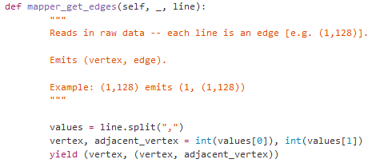


MapReduce Step 1: Read in Edges
Mapper Code:
Input/Output:
Input: List of Edges
Output:
(Node, Edge)
maps to

Slide 48
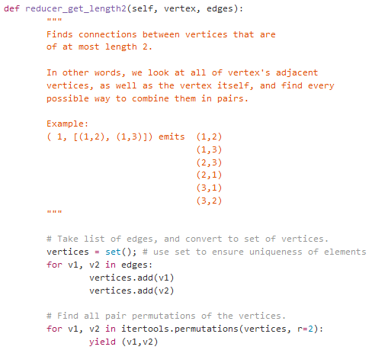


MapReduce Step 2: Simplify Graph
Reducer Code:
Input/Output:
Output:
List of edges (all connections that were originally of length 2 are now of length 1)
Input: (Node, All of Node’s Edges)
Reduces to

Slide 49
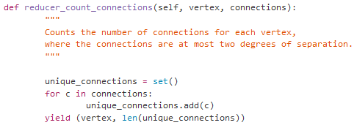

MapReduce Step 3: Count Connections (Ignoring Duplicates)
Reducer Code:
Input/Output:
Output:
(Node, #of conenctions)
Input: Node, (Edges)
Reduces to

Slide 50
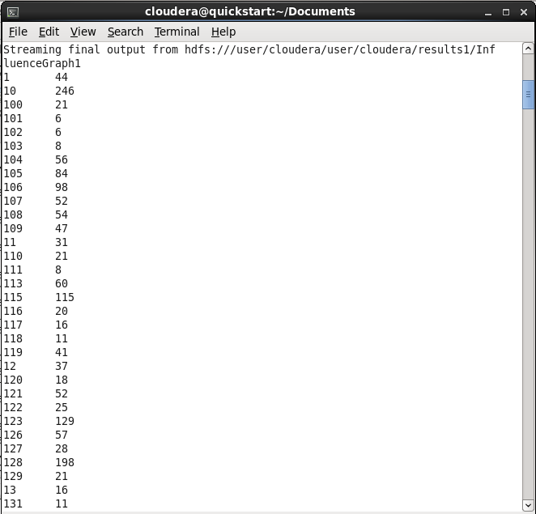
Output
Left column = nodes
Right column = influence

Slide 51
An Alternative Abstraction for Distributed Processing Resilient Distributed Datasets
Issues with Map Reduce:
Batch Orientation
Reuse of Output for Iterative Processes
Examples include many ML algorithms such as:
K Means
Logistic Regression
Random Forest
Page Rank
Interactive ML using multiple activities on same dataset.
That is: in-memory abstractions for distributed processing

Slide 52
A Quick Introduction to Spark

Slide 53
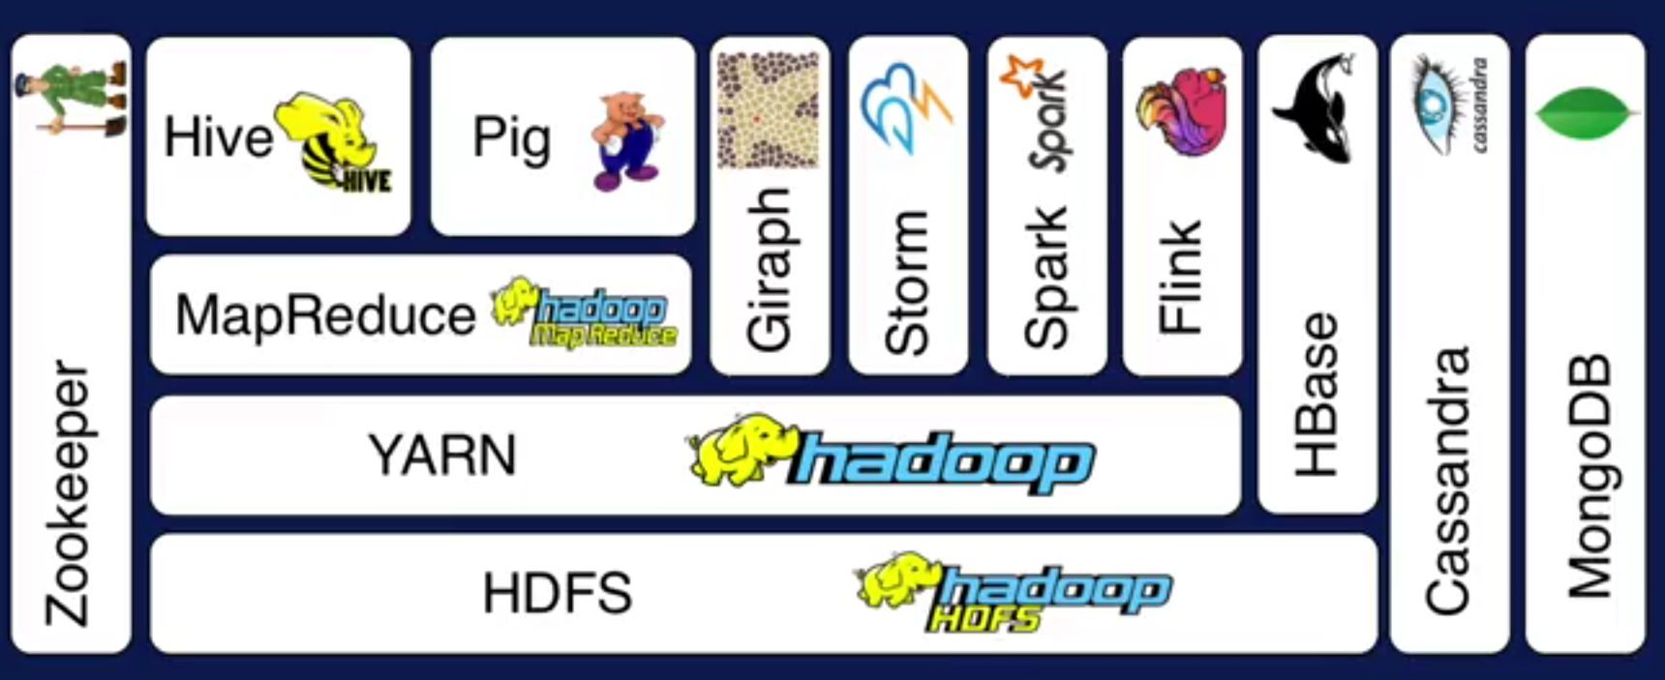
Hadoop Ecosystem
A
Layer Diagram
B
C
D
Source: Apache Hadoop and Spark: Introduction and Use Cases for Data Analytics; Afzal Godil, ITL, NIST

Slide 54

Spark Uses Memory instead of Disk
Hadoop: Use Disk for Data Sharing
HDFS
read
HDFS
Write
HDFS
read
HDFS
Write
Iteration1
Iteration2
Spark: In-Memory Data Sharing
HDFS read
Iteration1
Iteration2
Source: Apache Hadoop and Spark: Introduction and Use Cases for Data Analytics; Afzal Godil, ITL, NIST

Slide 55
Sort competition
 | Hadoop MR Record (2013) | Spark Record (2014)
Data Size | 102.5 TB | 100 TB
Elapsed Time | 72 mins | 23 mins
# Nodes | 2100 | 206
# Cores | 50400 physical | 6592 virtualized
Cluster disk throughput | 3150 GB/s (est.) | 618 GB/s
Network | dedicated data center, 10Gbps | virtualized (EC2) 10Gbps network
Sort rate | 1.42 TB/min | 4.27 TB/min
Sort rate/node | 0.67 GB/min | 20.7 GB/min
Spark, 3x faster with 1/10 the nodes
Sort benchmark, Daytona Gray: sort of 100 TB of data (1 trillion records)
http://databricks.com/blog/2014/11/05/spark-officially-sets-a-new-record-in-large-scale-sorting.html

